Slide 1

Migrating to Azure with Azure Migrate
Sarah Lean
Senior Cloud Advocate
Microsoft
@Techielass
www.techielass.com

Slide 2


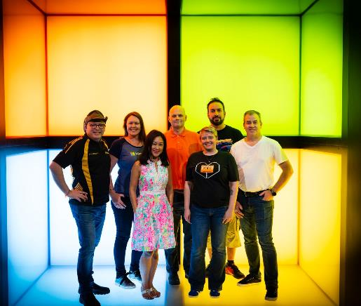
Who am I?
Senior Cloud Advocate @ Microsoft
Blog at www.techielass.com
@Techielass
Founder of the Glasgow Azure User Group
STEM Ambassador
14+ years in the IT industry
IT Pro

Slide 3
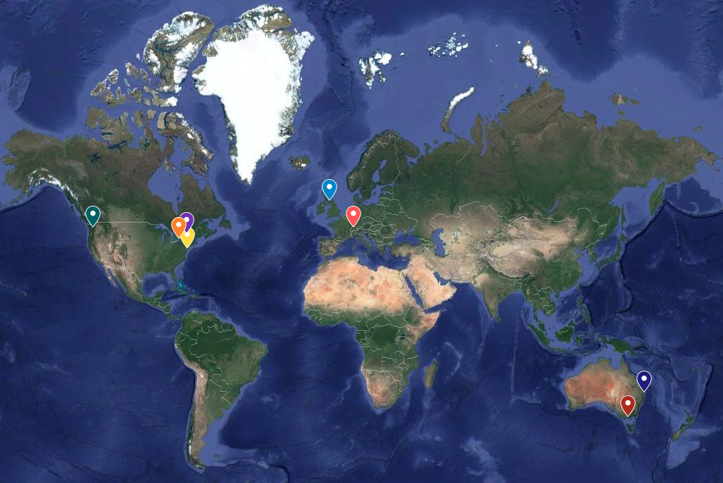

Slide 4

Scotland is the home of…

Slide 5
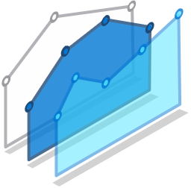

Migration Triggers
Cybersecurity threats
Cost efficiency & resource constraints
Fragile on-premises operations
Why are customers migrating?
Supporting remote work models
Meeting surge demand

Slide 6

Migration stages
Discovery
Assessment
Migrate
Optimise and manage
Foundational best practices: People | Process & Planning | Technology

Slide 7

Discovery
Understand your environment and objectives
Look at your environment
Understand dependencies
Understand your organisations needs
People and Technology
Staff training needs
Cost of your current environment
https://aka.ms/discoverychecklist
Microsoft Azure | @Techielass

Slide 8



Tooling
Pick the tooling to help your workload discovery
Where does the tool store information?
How does it discover information?
How much does it cost?
Microsoft Azure | @Techielass

Slide 9
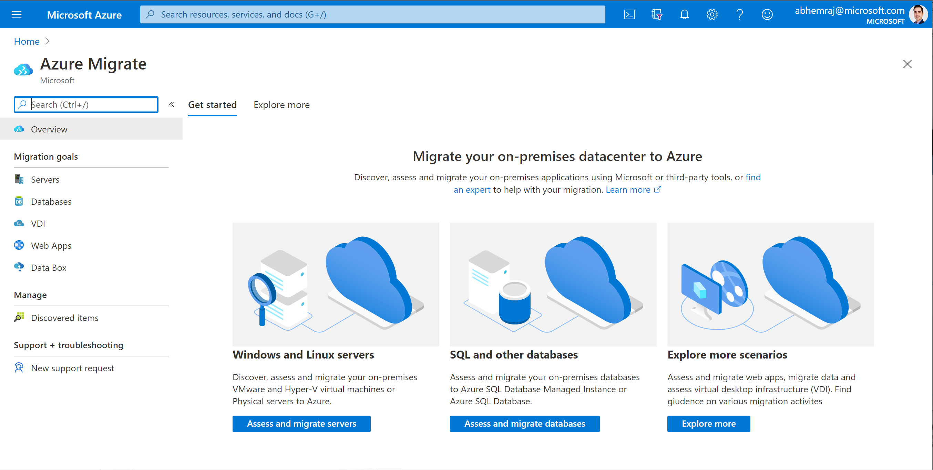
Azure Migrate
A central hub of tools for your datacenter cloud migration
Multiple scenarios
Coverage for servers (Windows/Linux), databases, VDI, web apps, and large volumes of data
Migration targets include Azure VMs, AVS, App Service and Azure SQL
Microsoft Azure | @Techielass

Slide 10
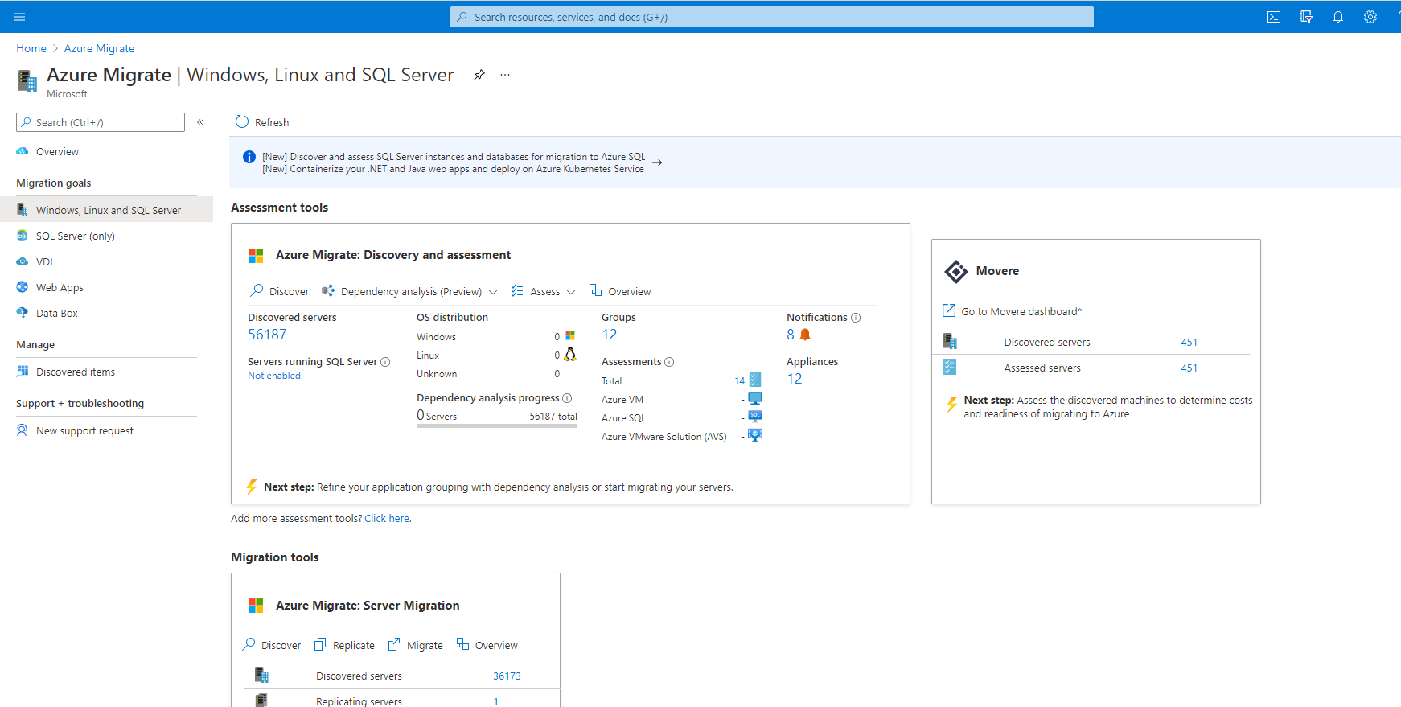
Azure Migrate
A central hub of tools for your datacenter cloud migration
End-to-end visibility
Centralized migration repository delivering end-to-end tracking and insights
Microsoft Azure | @Techielass

Slide 11








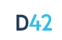



Choice of tools for every stage and every requirement
Servers
Databases
Web apps
VDI
Data
Azure Migrate:
Server Assessment
Azure Migrate:
Database Assessment (DMA)
Azure Migrate: Web App Assessment
Lakeside: SysTrack
Azure Databox
(Third Party Tool)
Azure Migrate:
Server Migration
Azure Migrate: Database Migration (DMS)
Azure Migrate: Web App Migration
Azure Migrate:
Server Migration
Movere
Partner tools
Cloudamize
Turbonomic
UnifyCloud
Device42
RackWare
Microsoft Azure | @Techielass

Slide 12
Azure Migrate appliance
Unified appliance
For server discovery, assessment and migration.
For VMware: discovery, assessment and migration
For Hyper-V: discovery and assessment
For physical and other clouds: discovery and assessment
Dedicated machine
Installed in source environment
Runs Azure Migrate software to connect to vCenter/Hyper-V host/physical servers/virtual machines to perform discovery
Deployment options
Virtual appliance that can be imported – OVA option for VMware, VHD option for Hyper-V
Installer option on dedicated Windows Server 2016 for all scenarios
Deploy as VM or physical machine
No impact to source
Appliance does not install any software on source VMs or hosts
Microsoft Azure | @Techielass

Slide 13

Discover: Capabilities
Any platform
VMware, Hyper-V, physical servers, AWS, GCP
CMDB, CSV imports
Agentless discovery
For all hypervisors, bare-metal servers and servers on other clouds
Inventory applications
And roles enabled on servers (only for VMware)
Visualize dependencies
Across application layers or across servers (agentless for VMware)
Microsoft Azure | @Techielass

Slide 14





Discovery: Supported versions & pre-requisites
VMware
Hyper-V
Physical/other cloud
Host requirements
ESXi hosts version (5.5 or later)
Host requirements
Windows Server 2012 R2 or later
PowerShell remoting
Administrator permissions
For Windows servers
Local or domain joined account
vCenter requirements
vCenter Server version (5.5, 6, 6.5, 6.7, 7)
Read-only account
For Linux servers
An account with root permissions
Supported VMs
All operating systems
Disks attached to SCSI, IDE, SATA controllers
Supported VMs
All operating systems
Hyper-V Integration Services enabled
Supported VMs
All operating systems
Microsoft Azure | @Techielass

Slide 15
How is everything connected?
Microsoft Azure | @Techielass

Slide 16


Dependency analysis: Supported versions & pre-requisites
VMware (agentless)
Hyper-V/ physical servers/
other cloud servers
On VMs PowerShell 2.0 VMware tools 10.2.0 or later Administrator account
On vCenter Read-only account with Virtual Machines -> Guest Operations privilege
Supported VMs Windows Server 2008 R2 and above Red Hat Enterprise Linux 7, 6, 5 Ubuntu Linux 14.04, 16.04 Debian 7, 8 Oracle Linux 6, 7 CentOS 5, 6, 7
On VMs Microsoft Monitoring agent Dependency agent
On Azure Log Analytics workspace
Supported VMs All except Windows Server 2003 SUSE Linux
*These are in addition to the pre-requisites called out for server discovery
Microsoft Azure | @Techielass

Slide 17





Dependency analysis: Process
Agentless for VMware VMs
Deploy and configure the Azure Migrate appliance in the source environment
Appliance discovers servers and server configurations, and collects performance data (resource utilizations) for Windows and Linux servers
Enable dependency analysis for each server on Azure Portal
View application inventory, roles on servers, and dependencies across servers
Microsoft Azure | @Techielass

Slide 18
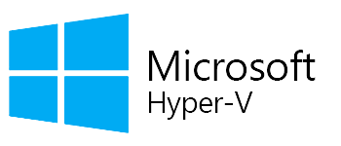

Dependency analysis:
Agent-based for Hyper-V VMs/physical servers/AWS, GCP, other cloud services
Configure Azure Log Analytics and Service Map with Azure Migrate project
Deploy Microsoft Monitoring Agent (MMA) and dependency agent on source servers
Agents send dependency information from Windows and Linux servers to Log Analytics workspace linked to Azure Migrate Project
View dependencies across servers
Microsoft Azure | @Techielass

Slide 19
Pull the data together
Microsoft Azure | @Techielass

Slide 20
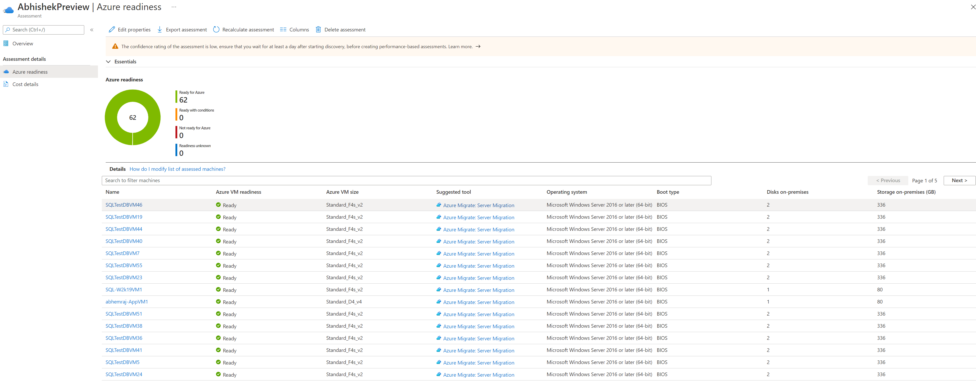
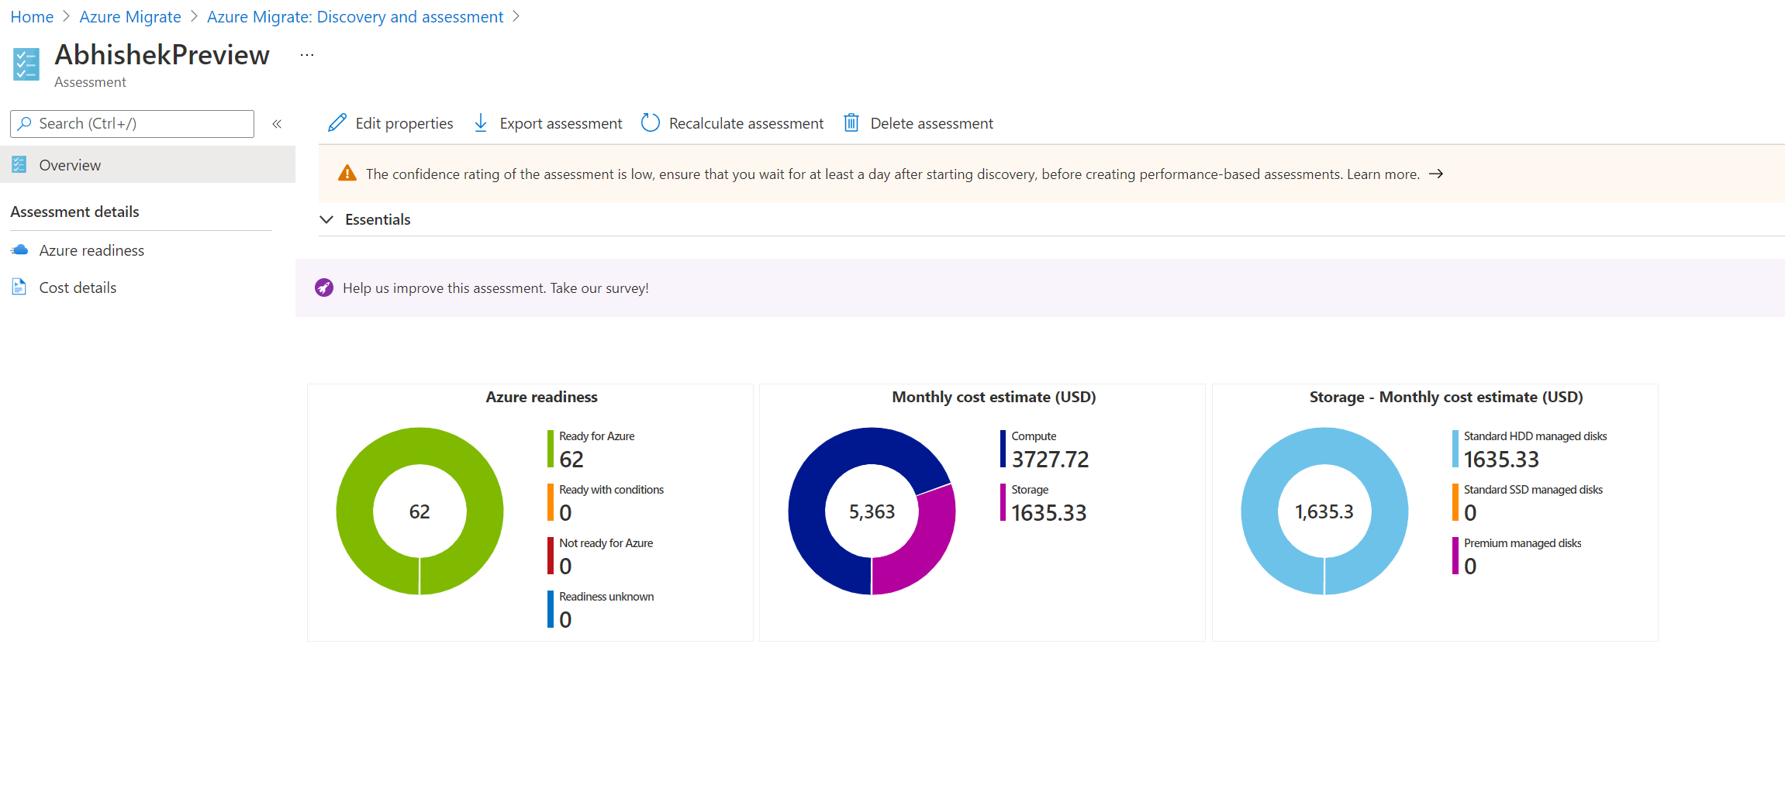
Reporting
Microsoft Azure | @Techielass

Slide 21
Assessment: Confidence rating computation or performance-based
For performance-based
Computation formula:
Output is categorized as:
0 to 20% data points
Confidence rating
Actual data point received
100 pts
x
20 to 40% data points
Expected data points
40 to 60% data points
Duration of assessments in mins
60 to 80% data points
Expected data points
10 mins
80 to 100% data points
Low confidence ratings indicate fewer data points availability. Could be due to:
Shorter profiling period (performance history duration > actual period for which data was available)
On-prem VMs shutdown
Appliance unable to load perf data
Temporary appliance shutdown
Microsoft Azure | @Techielass

Slide 22

Assessment
Use the data to strategize
Strategize your migration
What’s migration, what’s not migrating?
How are you migrating?
What’s the plan?
Start to think about the bigger picture
Microsoft Azure | @Techielass

Slide 23

Operations Management
What does the future look like?
Backup
Monitoring
Disaster Recovery
Roles and Responsibilities
Procedures
Cost Management
https://aka.ms/azurelive/manage
Microsoft Azure | @Techielass

Slide 24
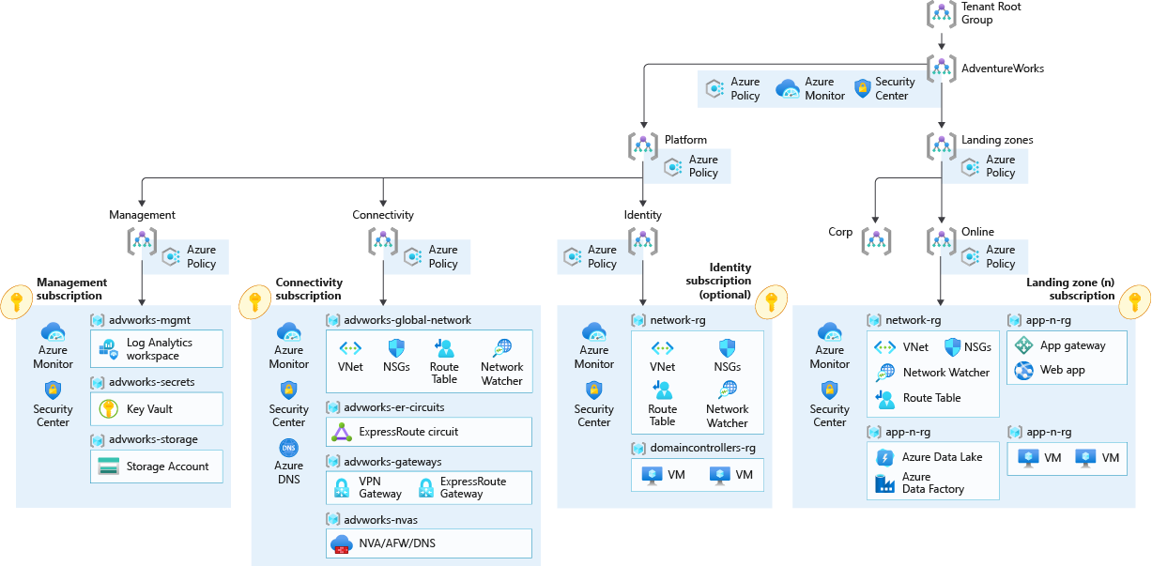
Landing Zone
What do you need to run you resources?
https://aka.ms/azurelive/landingzone
Microsoft Azure | @Techielass

Slide 25
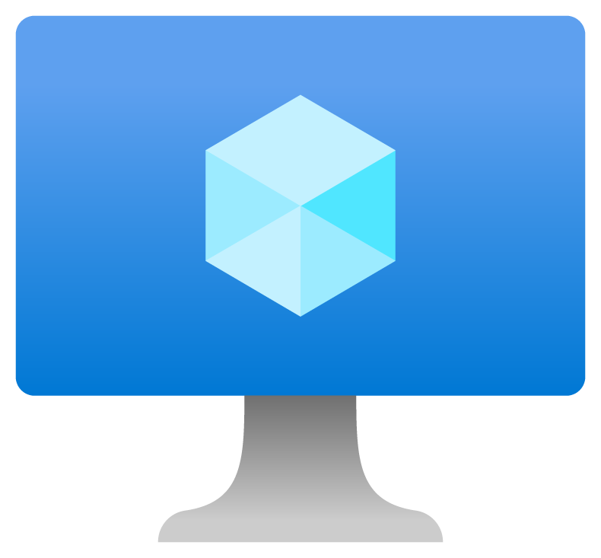
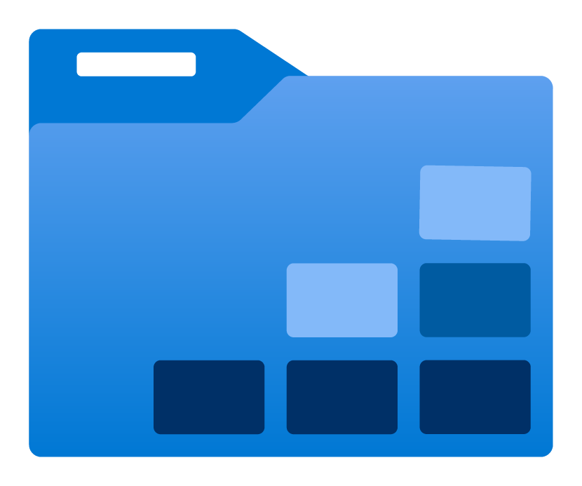
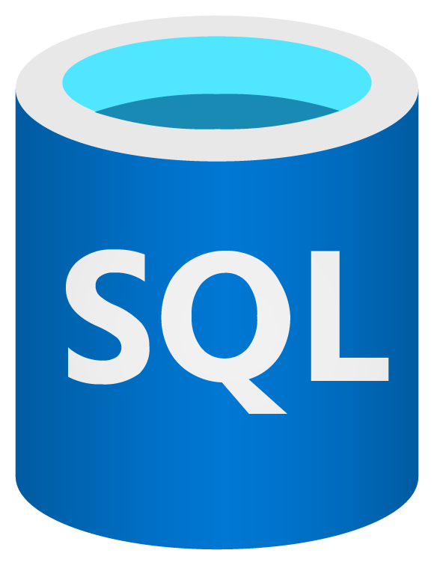

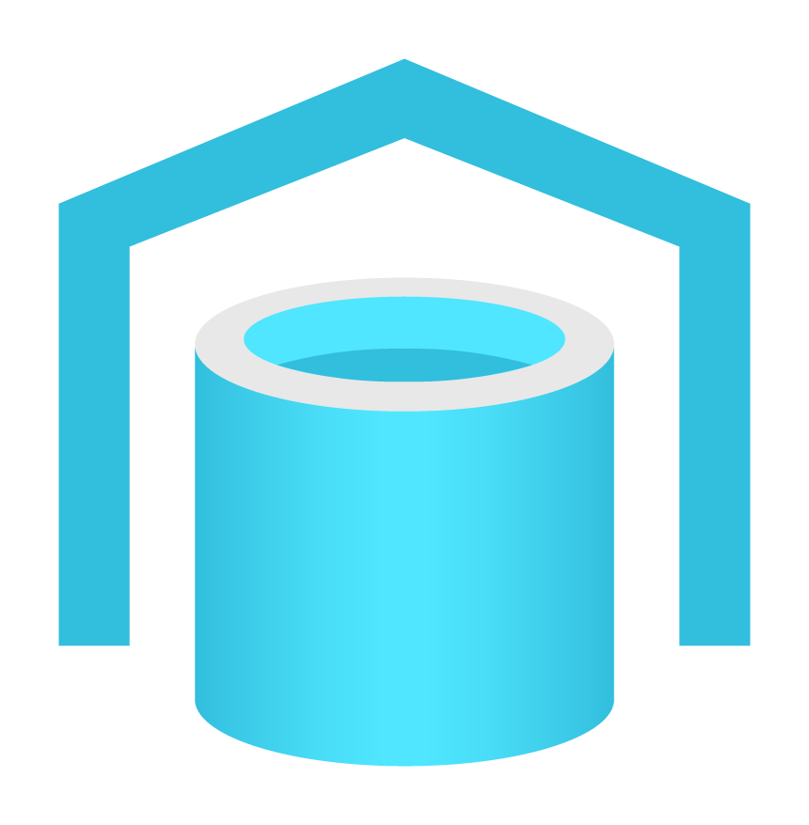

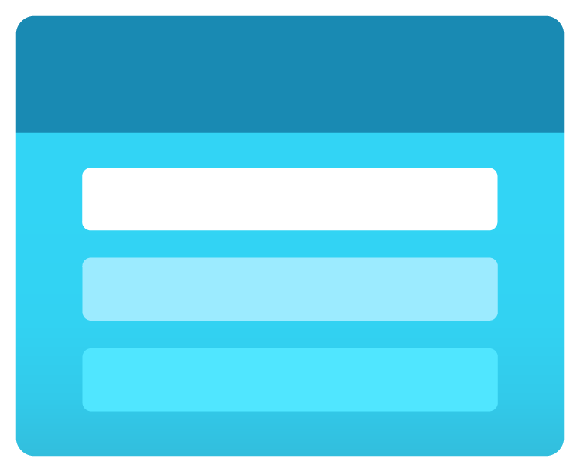


What are Azure Reservations?
Azure Reservations are a 1 or 3-year commitment to specific Azure services.
In exchange for committing to use the service in a predesignated way, Microsoft provides significant cost savings to the customer.
Virtual Machines
Azure Data Explorer
SQL Database
Azure Databricks
SQL Data Warehouse
App Services
Red Hat, SUSE & VMware by CloudSimple software plans
Azure Storage
Cosmos DB
Microsoft Azure | @Techielass

Slide 26
Azure Hybrid Benefit
A licensing benefit that lets you bring your on-premises Windows Server and SQL Server licenses with active Software Assurance to Azure and helps to significantly reduce the costs of running your workloads in the cloud.
Microsoft Azure | @Techielass

Slide 27

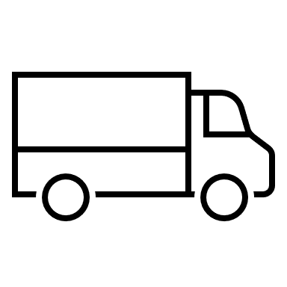
Migrate
Time to move
Don’t start with your most important workload
Communication
Iterate and learn
https://aka.ms/azurelive/migrate
Microsoft Azure | @Techielass

Slide 28
Agentless VMware: Process
Deploy and configure the Azure Migrate appliance for VMware and complete server discovery
Start replicating your Windows and Linux servers
The Azure Migrate appliance orchestrates the replication of your VM data to your Azure subscription
Perform test migrations (optional, but highly recommended) to a sandbox environment with no impact to production to validate migration
Migrate to Azure with zero data loss and minimal downtime
Sandbox environment
Microsoft Azure | @Techielass

Slide 29
Agentless Hyper-V: Process
Deploy Hyper-V Replication Provider on Hyper-V host
Start replicating your Windows and Linux servers using Azure Migrate: Server Migration
The Hyper-V Replication Provider orchestrates the replication of your VM data to your Azure subscription
Perform test migrations to a sandbox environment with no impact to production to validate migration
Migrate to Azure with zero data loss and minimal downtime
Sandbox environment
Deploy Hyper-V Replication Provider on Hyper-V host
Start replicating your Windows and Linux servers using Azure Migrate: Server Migration
The Hyper-V Replication Provider orchestrates the replication of your VM data to your Azure subscription
Perform test migrations to a sandbox environment with no impact to production to validate migration
Migrate to Azure with zero data-loss and minimal downtime
Microsoft Azure | @Techielass

Slide 30
Agent-based: Process
Deploy Replication appliance (also known as configuration server) in your source environment
Install Mobility Service on the servers to be migrated
Start replicating your Windows and Linux servers using Azure Migrate: Server Migration
Replication appliance orchestrates the replication of your VM data to your Azure subscription
Perform test migrations to a sandbox environment with no impact to production to validate migration
Migrate with minimal downtime
For physical servers/AWS, GCP, other cloud servers
Sandbox environment
Deploy Hyper-V Replication Provider on Hyper-V host
Start replicating your Windows and Linux servers using Azure Migrate: Server Migration
The Hyper-V Replication Provider orchestrates the replication of your VM data to your Azure subscription
Perform test migrations to a sandbox environment with no impact to production to validate migration
Migrate to Azure with zero data-loss and minimal downtime
Microsoft Azure | @Techielass

Slide 31
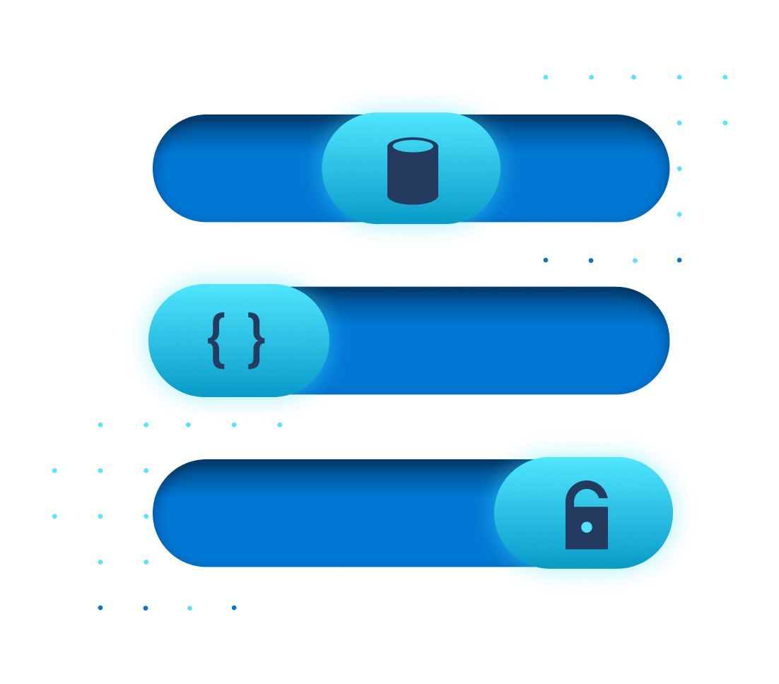
Migration: Test Migration
How do I demarcate a sandbox environment?
By specifying a Virtual Network while starting test migration
Subnet is automatically selected in following priority -
Subnet with same name as the target subnet specified while enabling replication
First subnet available alphabetically that is not a gateway/application gateway/firewall/bastion subnet
What is it?
Creates test copies of replicating servers in an Azure sandbox environment
Intended to help validate server and app functionality
Non-disruptive to source server and ongoing replication
Can be performed multiple times once Initial Replication is completed
Microsoft Azure | @Techielass

Slide 32
Migration: Bandwidth Consumption
To what does this asterisk refer?
For agentless migrations
For agent-based migrations
Estimate time needed or bandwidth required based on volume of data
Time to complete initial replication = {size of disks (or used size if available) * 0.7 (assuming a 30 percent compression average)}/bandwidth available for replication
For VMs on the same ESXi host:
Use Azure Site Recovery Deployment planner tool. Outputs from the tool include:
Estimated network bandwidth required
Projected throughput for replication
Concurrent replications that can be enabled (for specified time period to complete migration)
Disks to be used for Azure VMs (standard, premium)
Microsoft Azure | @Techielass

Slide 33
Migration: Replication Bandwidth Throttling
For agentless VMware migrations
For agentless Hyper-V migrations
For agent-based migrations
Set the NetQoSPolicy with throttle rate on Azure Migrate appliance
On the Hyper-V host
To control upload bandwidth, use the Windows Azure Backup MMC snap-in and configure maximum bandwidth to use
To increase upload efficacy, increase the number of threads used for data upload
On the replication appliance (configuration server) and/or scale-out process servers
To control upload throughput, use the Windows Azure Backup MMC snap-in and configure maximum bandwidth to use
To increase upload efficacy, increase the number of threads used for data upload
Microsoft Azure | @Techielass

Slide 34



Migration: Using ExpressRoute
On-premise environment
Replication appliance
(agent-based)
Hyper-V Replication Provider
Azure Migrate appliance - VMware
Replication data can be routed through ExpressRoute with Microsoft Peering
Control plane (replication orchestration) communications happen over the Internet
To configure Microsoft Peering for replication data transfer, advertise routes for following BGP communities –
Regional BGP community for the source Azure region (Azure Migrate Project region)
Regional BGP community for the target Azure region (region for migration)
BGP community for Azure Active Directory (12076:5060)
If using proxy setup on-premise, then configure proxy bypass for “.*.blob.core.windows.net”
Partner Edge
ExpressRoute circuit
Azure Edge
Azure Migrate
Azure Storage
Azure Compute
Orchestration data (over Internet)
Replication data (over ExpressRoute with Microsoft Peering)
Connectivity to Azure VM post failover (over ExpressRoute with Private Peering)
Microsoft Azure | @Techielass

Slide 35


Optimise and Manage
Understand your environment and objectives
Understanding training plans
Look at cost optimisations
Look at operations optimisations
Automation
Future planning
Microsoft Azure | @Techielass

Slide 36

Azure Advisor
Free personalized guide to Azure best practices
Best practices to set up and optimize your Azure workloads
Simple, step-by-step guidance and quick actions for fast remediation
One place to review and act on recommendations across Azure
Alerts and digests to notify you about new recommendations
Cost
Maximize the return on your Azure investment
Security
Protect your Azure resources from security threats
Performance
Boost speed and responsiveness of your resources
Reliability
Increase uptime of your business-critical apps
Operational excellence
Process and workflow efficiency and manageability
Microsoft Azure | @Techielass

Slide 37
Cost Optimisation
Cost optimization in the large enterprises is a difficult task. The conversation shouldn’t just be about cutting costs but about running responsibly.
Microsoft Azure | @Techielass

Slide 38
No migration is ever linear or simple…. Azure
Security and compliance
Migration plan
Specific migration workloads committed
Azure Foundations
Migration training
Technical skilling
Azure administration
Business strategy
Migration plan
Infrastructure security
Data protection
Incident response
Operations model
Technical resources
Cloud Strategy Team In Place (CDE)
Project management resources
Logging and monitoring
OS patching
High level business strategy
Key stakeholder sign off
Migration funding committed
Subscription design
Monitoring
Text
Identity and access management
Text
Text
Text
Text
Text
Text
Text
Text
Text
Text
Text
Text
Text
Text
Text
Text
Text
Text
Text
Text
Text
Text
Text
Text
Text
Text
Text
Text
Text
Text
Text
Text
Text
Text
Text
Text
Text
Text
Text
Text
Text
Text
Financial analysis
Text
Backup
Governance
Migration execution
TCO/ business case
Landing zone
Networking
Security RACI
Disaster recovery
Customer/ partner contract
Migration strategy
Identity
Shared responsibility model understood
Cloud operations
Configuration and change management
Pilot applications and VM identification
Partner support
Migration partner
Cost management
Cloud operational processes and run books
e2e test
Migration execution
Migration support
DevOps and automation
Azure operations partner
Migration targeted scope
Migration factory offering
Scan
Assessment
Workload owner buy-in or alignment
Discovery and assessment
Drawn from 100s of engagements by FastTrack for

Slide 39






Key Learnings
What does success look like?
Involve the Business at every step
Script and Automate where you can
Choose the right tools for the job
Track and optimize spend

Slide 40
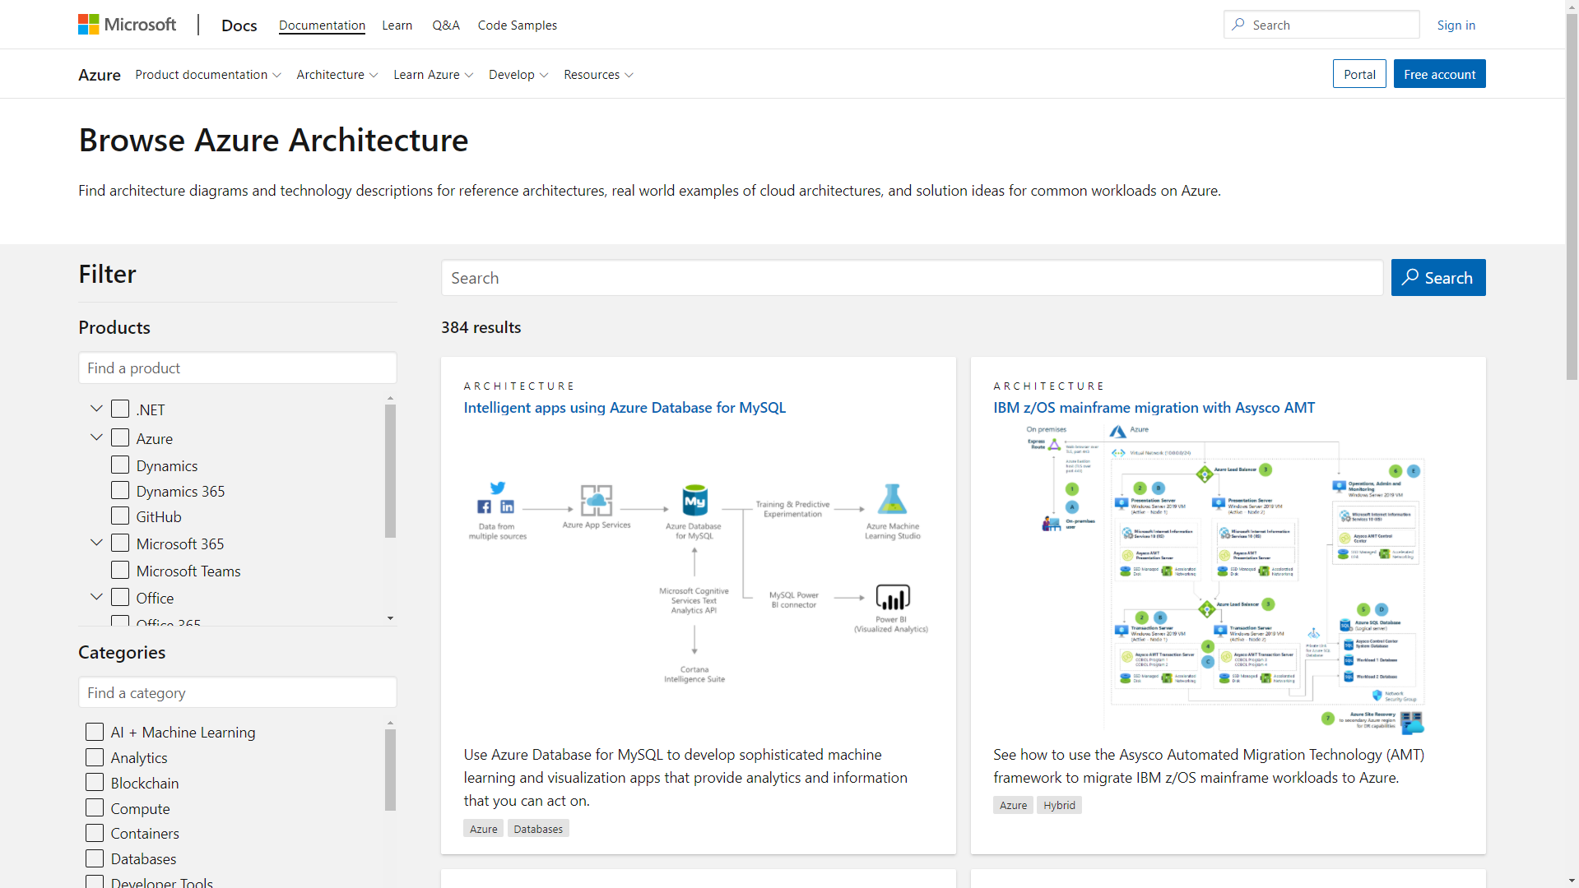

Azure Architecture Center
https://aka.ms/AzureAC
Microsoft Azure | @Techielass

Slide 41
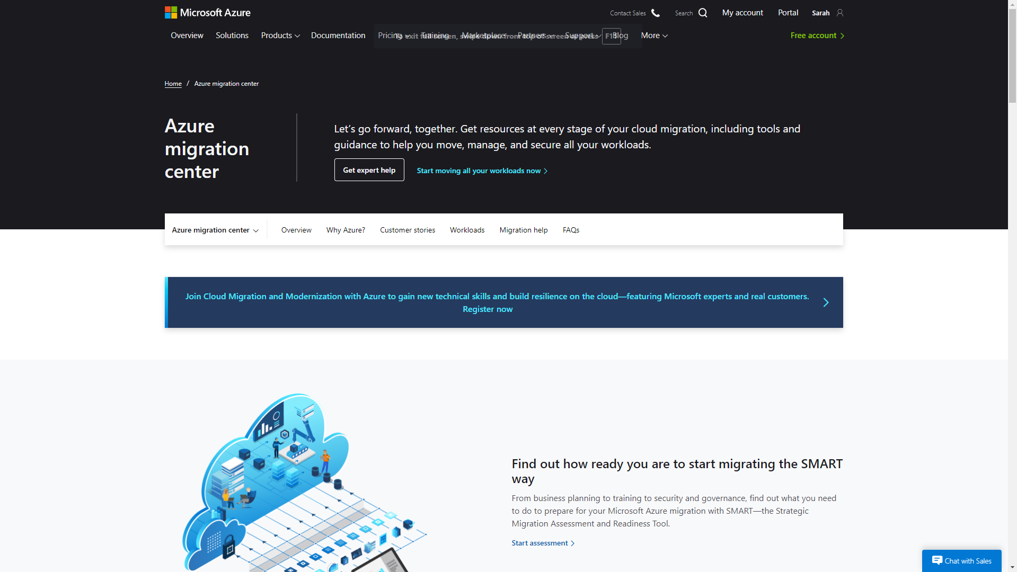
Azure migration center
Guidance
Tools
Partners
Migration journey and strategies
Right tools for the job
Migration experts
https://aka.ms/azurelive/migration

Slide 42
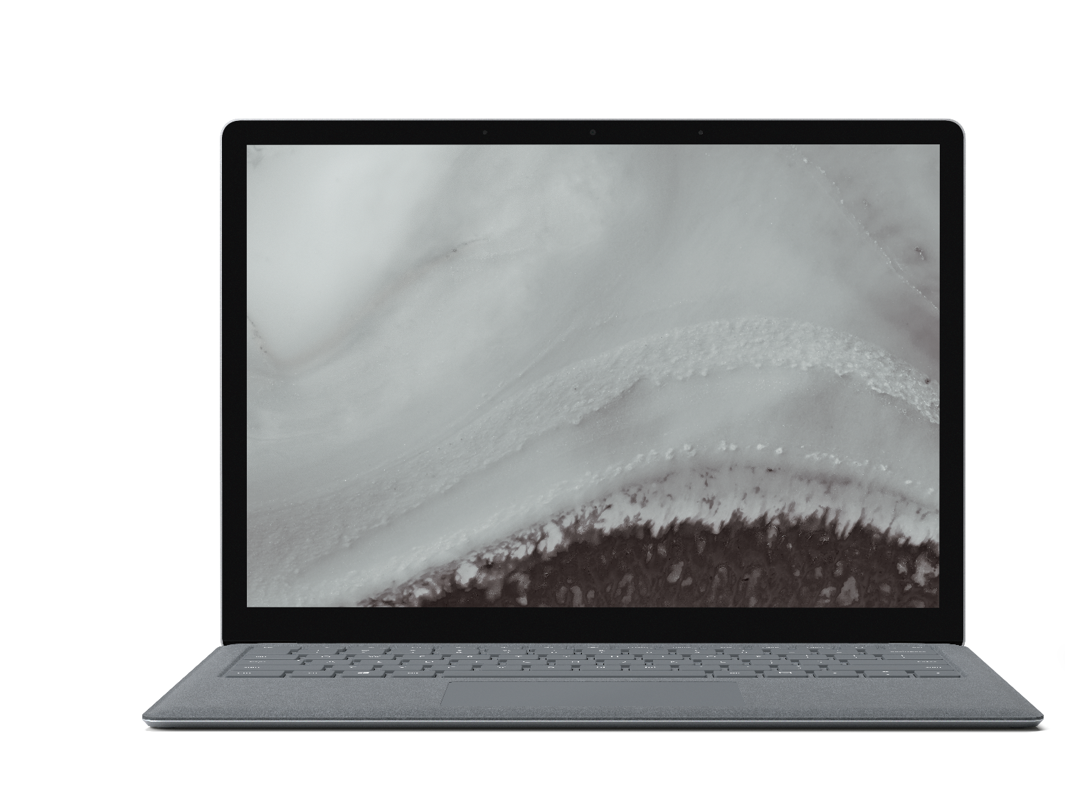
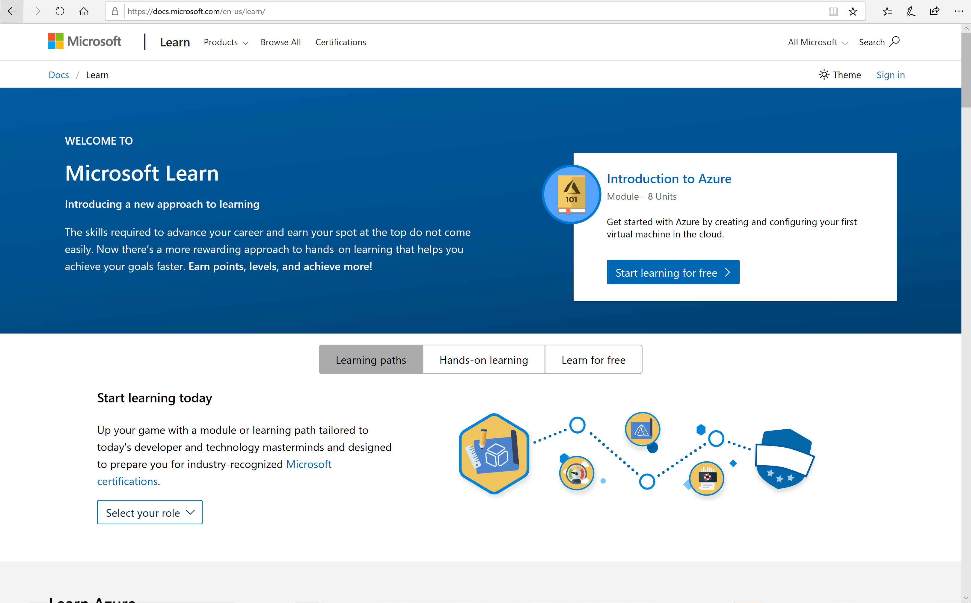
Microsoft Learn
Hundreds of learning paths, completely free
Step-by-step tutorials
Browser-based interactive learning
environments
https://aka.ms/azurelive/learn

Slide 43

Thank you! Resources: https://aka.ms/migrate-to-azure
Sarah Lean
Senior Cloud Advocate
@Techielass
www.techielass.com

